Slide 1

BOOLEAN ALGEBRA and LOGIC GATES
20XC14 DIGITAL SYSTEM DESIGN

Slide 2
Lecture Outline
Introduction
Basic Operations: NOT, AND, OR
Representations of Boolean Expressions
Basic Boolean Theorems
Implementation of Boolean Expressions

Slide 3
Overview
Gate Circuits and Boolean Equations
Binary Logic and Gates
Boolean Algebra
Standard Forms
Circuit Optimization
Two-Level Optimization
Map Manipulation
Multi-Level Circuit Optimization
Additional Gates and Circuits
Other Gate Types
Exclusive-OR Operator and Gates
High-Impedance Outputs

Slide 4
Binary Logic and Gates
Binary variables take on one of two values.
Logical operators operate on binary values and binary variables.
Basic logical operators are the logic functions AND, OR and NOT.
Logic gates implement logic functions.
Boolean Algebra: a useful mathematical system for specifying and transforming logic functions.
We study Boolean algebra as foundation for designing and analyzing digital systems!

Slide 5
Binary Variables
Recall that the two binary values have different names:
True/False
On/Off
Yes/No
1/0
We use 1 and 0 to denote the two values (True/False)
Variable identifier examples:
A, B, y, z, or X₁ for now
RESET, START_IT, or ADD1 later

Slide 6
Boolean Algebra- Introduction
Boolean Algebra
In 1849 George Boole published a scheme for the algebraic description of logic processes
In the 1930’s Claude Shannon used Boolean Algebra to describe circuits built with switches
Boolean Algebra is an effective tool for describing logic circuits

Slide 7
Boolean Algebra -Boolean Logic
+5
1
0
1
V
T
ime
Two logic levels
TRUE = HIGH = 1
FALSE = LOW = 0
0
+5
Transition from logic 1 to logic 0
does not take place instantaneously
in real digital systems
Logic 1
V
Intermediate values may be visible
for an instant
Logic 0
0
Time

Slide 8
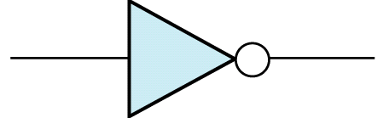

Boolean Algebra -Basic Operations: NOT, AND, OR
Logical NOT
Description:
The output is the complement/inverse/opposite of the input
Symbolic Representation (NOT gate):
Truth Table Representation:
Boolean Description: C = NOT A
A
C
A | C
0 | 1
1 | 0
A | C
F | T
T | F
or C = A’
or C = $\overline{A}$

Slide 9
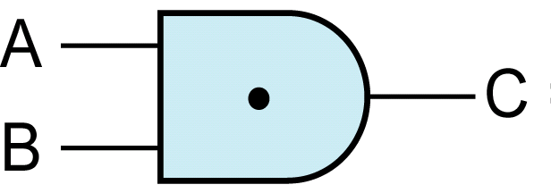
Boolean Algebra-Basic Operations: NOT, AND, OR
Logical AND
Description:
The output is TRUE if and only if all the inputs are TRUE
Symbolic Representation (AND gate):
Truth Table Representation:
Boolean Description: C = A AND B
A | B | C
0 | 0 | 0
0 | 1 | 0
1 | 0 | 0
1 | 1 | 1
A | B | C
F | F | F
F | T | F
T | F | F
T | T | T
or C = A⋅B
or C = A B

Slide 10
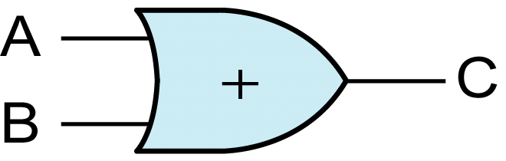
Boolean Algebra- Basic Operations: NOT, AND, OR
Logical OR
Description:
The output is TRUE if any of the inputs are TRUE
Symbolic Representation (OR gate):
Truth Table Representation:
Boolean Description: C = A OR B
A | B | C
0 | 0 | 0
0 | 1 | 1
1 | 0 | 1
1 | 1 | 1
A | B | C
F | F | F
F | T | T
T | F | T
T | T | T
or C = A + B

Slide 11
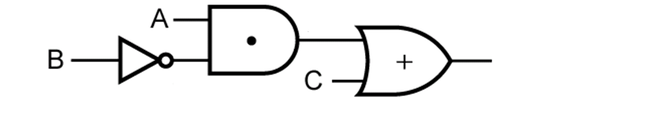
Boolean Algebra Logic Gates and Boolean Expressions
Derive an expression for the output of this logic circuit?
Eventually we will omit the “⋅” in the AND gate and “+” in the OR gate
The logic expression is a function of three variables (A, B, and C).
A⋅B’
A⋅B’+C
B’

Slide 12
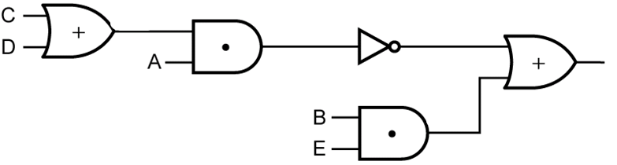



Boolean Algebra -logic Gates and Boolean Expressions
Derive an expression for the output of this logic circuit?
The output is $\overline{\text{A}\text{(}\text{C}\text{+}\text{D}\text{)}}+BE$ which may also be written as [A(C+D)]’+BE
This expression has five variables (A, B, C, D, and E)
C+D
A(C+D)
$$\overline{\text{A}\text{(}\text{C}\text{+}\text{D}\text{)}}$$
$\overline{\text{A}\text{(}\text{C}\text{+}\text{D}\text{)}}$+$BE$
BE

Slide 13
Boolean Algebra-Logic Gates and Boolean Expressions
Literals
Each appearance of a variable or its complement in an expression is referred to as a literal.
Example:
The expression has three variables (A, B, and C)
The expression has 10 literals
AB’C+A’B+A’BC’+B’C’

Slide 14
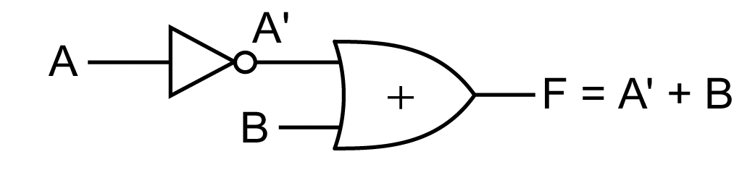
Boolean Algebra- Truth Tables of a Logic Circuit
Determine the truth table for the output (F) of the logic circuit
A | B
0 | 0
0 | 1
1 | 0
1 | 1
A’
1
1
0
0
F=A’+B
1
1
0
1
Two variables
⇒Four possible inputs (i.e. 2^{n})

Slide 15
Boolean Algebra - Truth Tables of a Logic Circuit
A+C
0
1
0
1
1
1
1
1
A+C
B’
1
1
0
0
1
1
0
0
B’+C
B’+C
1
1
0
1
1
1
0
1
(A+C)(B’+C)
0
1
0
1
1
1
0
1
A
0
0
0
0
1
1
1
1
B
0
0
1
1
0
0
1
1
C
0
1
0
1
0
1
0
1
(A+C)(B’+C)

Slide 16
Logic Function Implementation
Using Switches
For inputs:
logic 1 is switch closed
logic 0 is switch open
For outputs:
logic 1 is light on
logic 0 is light off.
NOT uses a switch such that:
logic 1 is switch open
logic 0 is switch closed
Switches in parallel => OR
Switches in series => AND
Normally-closed switch => NOT
C

Slide 17
Logic Function Implementation (Continued)
Example: Logic Using Switches
Light is on (L = 1) for
L(A, B, C, D) =
and off (L = 0), otherwise.
Useful model for relay circuits and for CMOS gate circuits, the foundation of current digital logic technology
B
C
A
D
Notes:
L (A, B, C, D) = A ((B C') + D) = A B C' + A D

Slide 18
Logic Gates
In the earliest computers, switches were opened and closed by magnetic fields produced by energizing coils in relays. The switches in turn opened and closed the current paths.
Later, vacuum tubes that open and close current paths electronically replaced relays.
Today, transistors are used as electronic switches that open and close current paths.

Slide 19

Logic Gate Symbols and Behavior
Logic gates have special symbols:
= =
And waveform behavior in time as follows:
=
$$=$$

Slide 20
BOOLEAN ALGEBRA - terminologies
The complement of a variable, A, is its inverse,
The variable or its complement is called a literal.
A is the true form of the variable and the A’ is the complementary form
The AND of one or more literals is called a product or an implicant.
A minterm is a product involving all of the inputs to the function.
ABC’ is a minterm for a function of the three variables A, B, and C
maxterm is a sum involving all of the inputs to the function(A+B’+C)

Slide 21
Boolean Algebra - Basic Boolean Theorems
Basic Theorems
Principle of DUALITY:
Given any Boolean expression its DUAL expression can be obtained by:
Replace “ • “ by “ + “ (and vice versa), also
Replace “ 0 “ by “ 1 “ (and vice versa)

Slide 22
Boolean Algebra
Axioms and theorems of Boolean algebra obey the principle of duality.

Slide 23
Boolean Algebra - Basic Boolean Theorems
Basic Theorems
Operations with 0 and 1
Expression
Dual of Expression
x⋅0 = 0
x+1 = 1
x⋅1 = x
x+0 = x
x | 0 | x+0
0 | 0 | 0
1 | 0 | 1
x | 1 | x+1
0 | 1 | 1
1 | 1 | 1
x | 0 | x⋅0
0 | 0 | 0
1 | 0 | 0
x | 1 | x⋅1
0 | 1 | 0
1 | 1 | 1

Slide 24
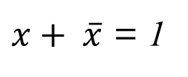
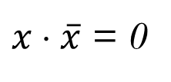

Boolean Algebra -Basic Boolean Theorems
Expression
Dual of Expression
x ⋅ x = x
x + x = x
Idempotent Law:
Laws of Complementarity
Involution Law
Expression
Dual of Expression
$x ⋅ \overline{x}$ = 0
$x+ \overline{x}$ = 1
$$\overset{̿}{x}=x$$

Slide 25
Boolean Algebra -More Boolean Theorems
Expression
Dual of Expression
Commutative Law
Associative Law
Distributive Law
x ⋅ y = y ⋅ x
x + y = y + x
Expression
Dual of Expression
(x ⋅ y) ⋅ z = x ⋅ (y ⋅ z)
(x + y) + z = x + (y + z)
Expression
Dual of Expression
x ⋅ (y + z) = (x ⋅ y) + (x ⋅ z)
x + (y ⋅ z) = (x + y) ⋅ (x + z)

Slide 27
how to prove that a theorem is true
Perfect induction
In Boolean algebra, proofs of theorems with a finite number of variables are easy
Show that the theorem holds for all possible values of these variables.
In Boolean equations, NOT has the highest precedence, followed by AND, then OR
Can be done with a truth table also.

Slide 28











Boolean Algebra -Boolean Algebra Examples
Prove the following algebraically
$$X\left(\overline{X}+Y\right)=XY$$
LHS
$$X\left(\overline{X}+Y\right)$$
$$=X\overline{X}+XY$$
Distributive Law
$$=0+XY$$
Complementary Law
$$=XY$$
Operations with 0 and 1
$$X+XY=X$$
LHS
$$X+XY$$
$$=X1+XY$$
Operations with 0 and 1
$$=X\left(1+Y\right)$$
Distributive Law
$$=X1$$
Operations with 0 and 1
$$=X$$

Slide 29









Boolean Algebra - Boolean Algebra Examples
Examples:
$$\left(X+Y\right)\left(X+Z\right)=X+YZ$$
Distributive Law (Dual)
LHS
$$\left(X+Y\right)\left(X+Z\right)$$
$$=X\left(X+Z\right)+Y\left(X+Z\right)$$
Distributive Law
$$=XX+XZ+YX+YZ$$
$$=X+XZ+XY+YZ$$
Idempotent Law
$$=X+XY+YZ$$
Last example: X+XZ = X
$$=X+YZ$$
Last example: X+XY = X
OR
$$X+XZ+XY+YZ=X(1+Z+Y)+YZ$$
$$=X(1)+YZ$$
$$=X+YZ$$

Slide 30
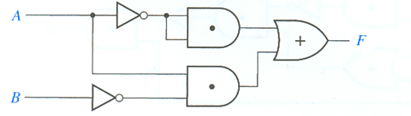










Boolean Algebra -A Circuit Example
Determine the Output of the Following Circuit
$$\overline{A}$$
$$\overline{A} \overline{A}$$
$$\overline{A} \overline{A}+A\overline{B}$$
$$A\overline{B}$$
$$\overline{B}$$
Design a Simpler Circuit with the Same Output
$$F=\overline{A} \overline{A}+A\overline{B}$$
Distributive Law (Dual)
$$=\overline{A}+A\overline{B}$$
x + (y ⋅ z) = (x + y) ⋅ (x + z)
$$=\left(\overline{A}+A\right)\text{⋅}\left(\overline{A}+\overline{B} \right)$$
$$=1\text{⋅}\left(\overline{A}+\overline{B} \right)$$
$$=\overline{A}+\overline{B}$$

Slide 31
Boolean Algebra More Boolean Theorems
Let’s verify the Distributive Law via a truth table
x (y + z) = x y + x z
LHS
RHS
x | y | z
0 | 0 | 0
0 | 0 | 1
0 | 1 | 0
0 | 1 | 1
1 | 0 | 0
1 | 0 | 1
1 | 1 | 0
1 | 1 | 1
y + z
0
1
1
1
0
1
1
1
y + z
x(y + z)
0
0
0
0
0
1
1
1
x(y + z)
x | y | z
0 | 0 | 0
0 | 0 | 1
0 | 1 | 0
0 | 1 | 1
1 | 0 | 0
1 | 0 | 1
1 | 1 | 0
1 | 1 | 1
x y
0
0
0
0
0
0
1
1
x y
x z
0
0
0
0
0
1
0
1
x z
x y + x z
0
0
0
0
0
1
1
1
x y + x z

Slide 32
Review of Commutative, Associative, and Distributive Laws
DeMorgan’s Law
Simplification Theorems

Slide 33
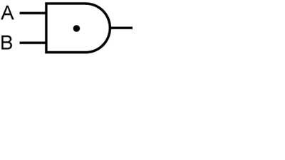
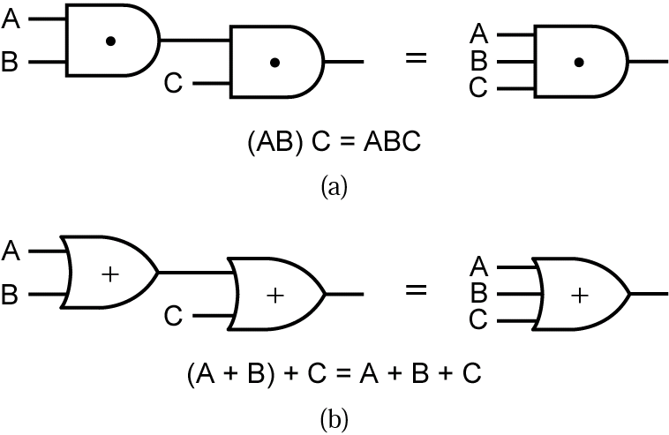
Boolean Algebra Review of Commutative Law
Commutative Law
Expression
Dual of Expression
x ⋅ y = y ⋅ x
x + y = y + x
x
x
y
y
≡
≡
y
y
x
x

Slide 34
Boolean Algebra -Review of Associative Law
Associative Law
Expression
Dual of Expression
(x ⋅ y) ⋅ z = x ⋅ (y ⋅ z)
(x + y) + z = x + (y + z)
x
LHS
x
LHS
y
y
z
z
≡
≡
y
y
RHS
z
RHS
z
x
x
≡
≡
x
x
y
x ⋅ y ⋅ z
y
x + y + z
z
z

Slide 35
Boolean Algebra -Review of Distributive Law
Distributive Law
Expression
Dual of Expression
x ⋅ (y + z) = x ⋅ y + x ⋅ z
x + y ⋅ z = (x + y) ⋅ (x + z)
y
y
LHS
LHS
z
z
x
x
≡
x
x
y
y
RHS
RHS
x
x
z
z

Slide 36
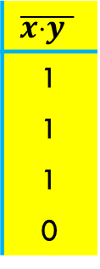
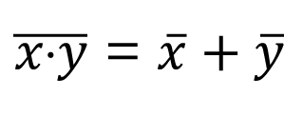
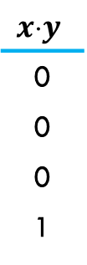
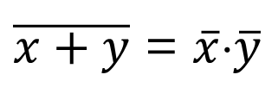
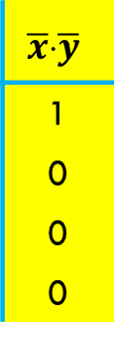
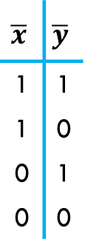
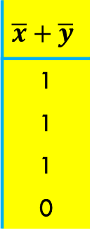
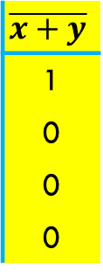
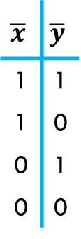
Boolean Algebra -DeMorgan’s Law
Expression
Dual of Expression
$\overline{x+y}$ = $\overline{x}⋅\overline{y}$
$\overline{x⋅y}$ = $\overline{x}+\overline{y}$
LHS
RHS
LHS
RHS
x | y
0 | 0
0 | 1
1 | 0
1 | 1
x+y
0
1
1
1
$$\overline{x+y}$$
1
0
0
0
$$\overline{x}$$ | $$\overline{y}$$
1 | 1
1 | 0
0 | 1
0 | 0
$$\overline{x}⋅\overline{y}$$
1
0
0
0
x | y
0 | 0
0 | 1
1 | 0
1 | 1
$$xy$$
0
0
0
1
$$\overline{x⋅y }$$
1
1
1
0
$$\overline{x}$$ | $$\overline{y}$$
1 | 1
1 | 0
0 | 1
0 | 0
$$\overline{x}+\overline{y}$$
1
1
1
0

Slide 37
Boolean Algebra -DeMorgan’s Law
DeMorgan’s Law
DeMorgan’s Law via gates
Expression
Dual of Expression
$\overline{x+y}$ = $\overline{x}⋅\overline{y}$
$\overline{x⋅y}$ = $\overline{x}+\overline{y}$
≡
x
x
RHS
RHS
y
y
≡
≡
x
x
LHS
LHS
y
y

Slide 38
Boolean Algebra DeMorgan’s Law
DeMorgan’s Law
DeMorgan’s Law via “pushing bubbles”
Expression
Dual of Expression
$\overline{x+y}$ = $\overline{x}⋅\overline{y}$
$\overline{x⋅y}$ = $\overline{x}+\overline{y}$
x
x
LHS
LHS
RHS
RHS
y
y
≡
≡
x
x
LHS
RHS
RHS
LHS
y
y

Slide 39
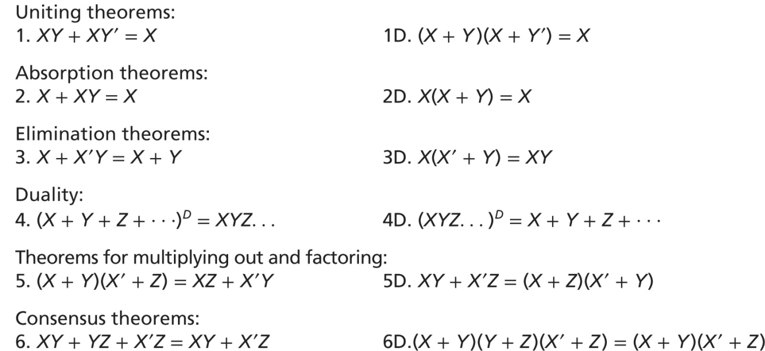
Boolean Algebra Simplification Theorems

Slide 40
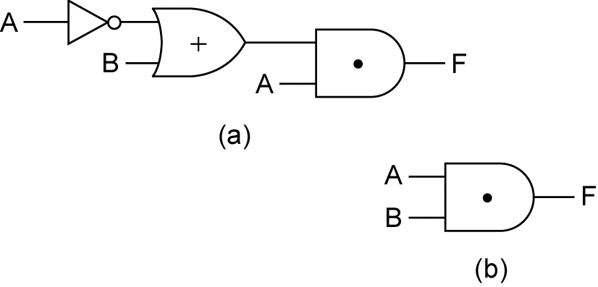
Boolean Algebra - Examples
Simplify the following circuit
Simplify:
≡
A
B

Slide 42
Next Lecture
Sum of Products / Product of Sums
Exclusive OR operation
Simplification
Proving equations (Validity)

